Slide 1
SpringBoot
Nov 2019

Slide 2
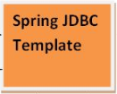





Agenda

Slide 3
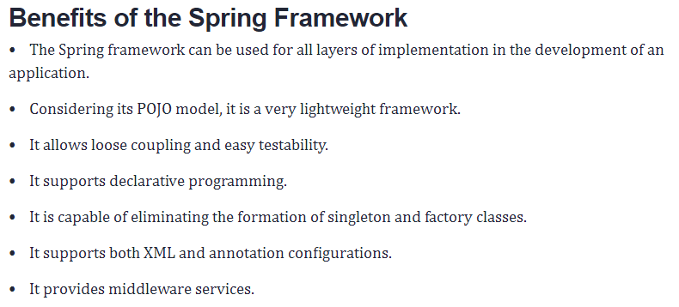
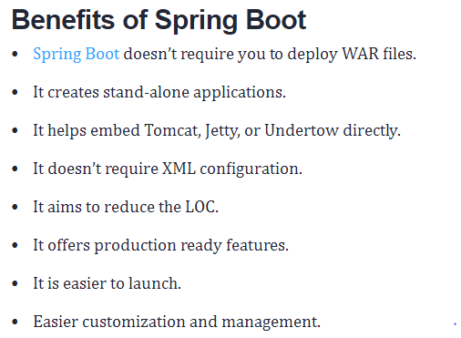
Spring Vs SpringBoot
https://www.baeldung.com/spring-vs-spring-boot

Slide 4
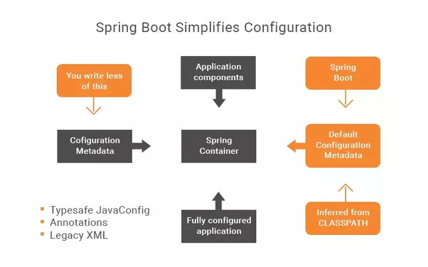
Reduces Manual Configuration

Slide 5
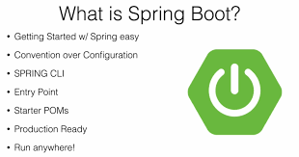
SpringBoot

Slide 6


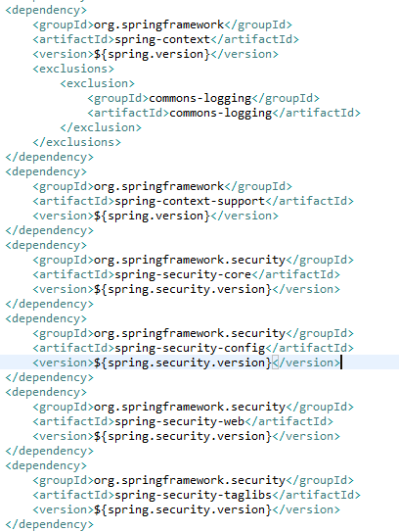
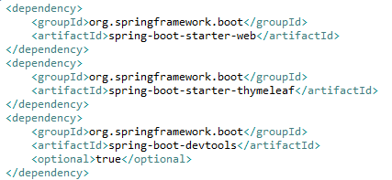
POM.xml

Slide 7
Benefits achieved through Selenium Automation
Process Improvement | Before Selenium Automation | After Selenium Automation
Time to Test | Manual testing - Takes longer time | Automation testing allows multiple Test Cases to be tested in very short time
Data Driven | Not Available | Data Driven made easy. Developer can just put in their inputs & Test Cases in Excel & Run the scripts.
Test Case Report | Not Available | Excel based reporting Records error snap shots Keeps track of both +ve & -ve cases
Regression | Manual | Made Easy
Mailing Alert | Not Available | Work In Progress. Implemented soon

Slide 8
Benefits achieved through SonarQube/Scanner & Lint
Process Improvement | Before Sonar Lint | After Sonar Lint
Review of Coding Standards | Verification of coding standards is dependent on degree of code review | Bugs, Vulnerabilities are identified by the developer on the go and also as a detailed report thereby ensuring proper standards are met
Technical Debts | Identification of technical debts is a tedious job once again dependent on degree of review | Automatic identification of technical debt along with detailed information on the issue
Developer Guidance | Not Available | Code Compliance guide available
Eclipse Plugin | N/A | Available

Slide 9
Benefits achieved through Security Vulnerability Checks By Veracode
Implementation | Before Veracode | After Veracode
Vulnerabilities | Existed Vulnerabilities (Very High, High & Medium) XSS – Cross Site Scripting CSRF – Cross Site Request Forgery SQL Injection "Carriage Return" and "Line Feed." | Cleared all Very High, High & Medium Vulnerabilities
Score | Scan Score : 35 | Scan Score Improved as follows. Mar Release Score : 73 April Release Score : 75 June Release Score : 100
SSL | Not Implemented | Implemented Fixed Back Button issue in Production in navisysfo Fixed ajax utility issue in Sunview

Slide 10

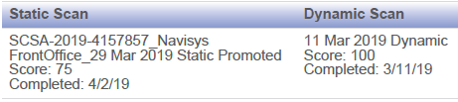
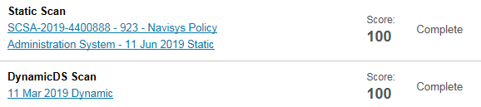
Veracode Report
March Release
April Release
June Release

Slide 11
Road Ahead…
Implementation | Purpose of Implementation
Code Profiling (Visual VM) | Identify Memory Leaks
Asynchronous Loggers | Performance Tuning Measure upon loggers
Code Minification | Performance Tuning Measure upon CSS, JavaScript & HTML pages.

Slide 12
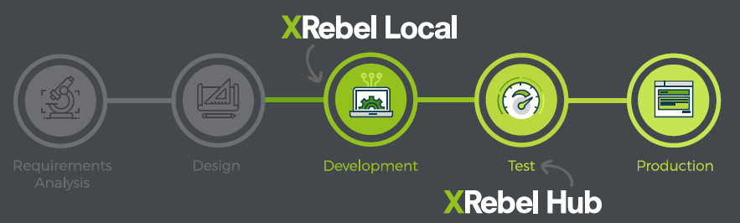
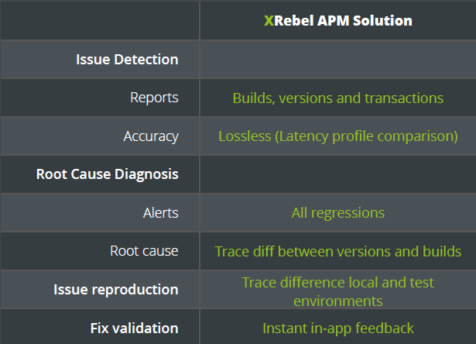
XRebel- APM

Slide 13
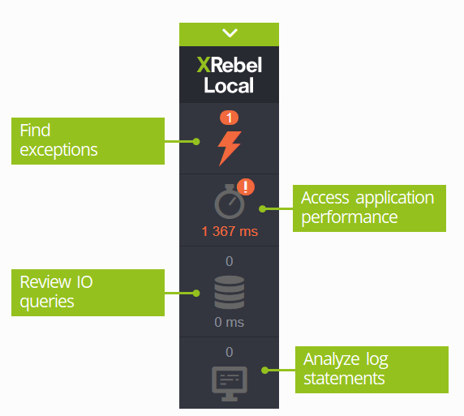
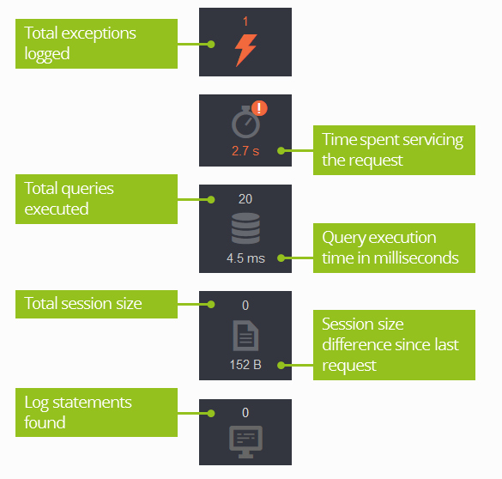
XRebel- APM

Slide 14
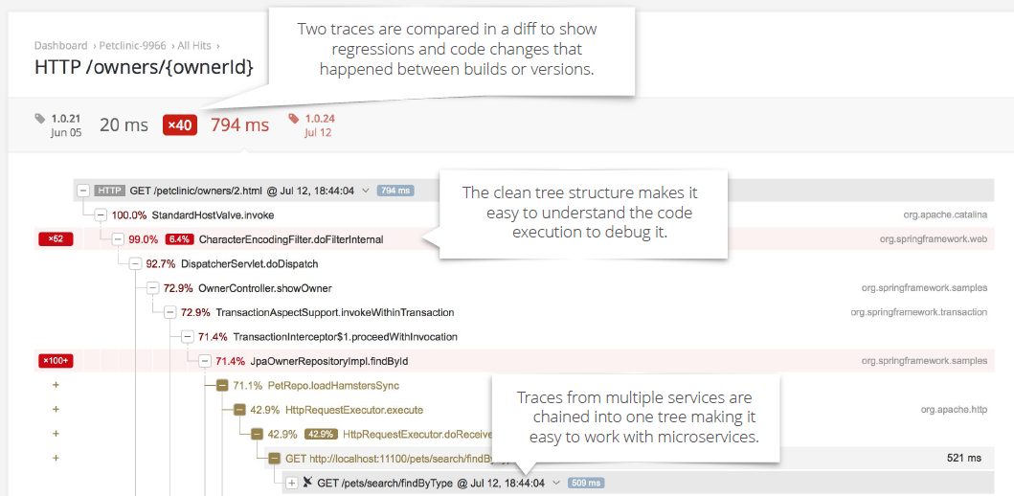
Xrebel APM Trace / Call Graph

Slide 15
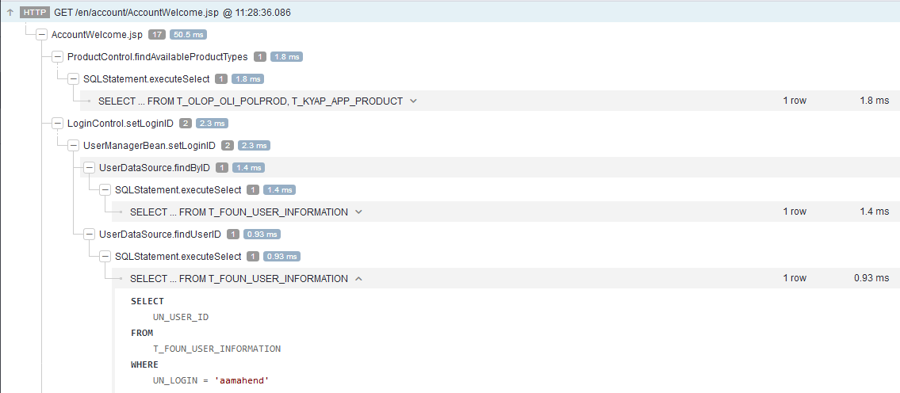
Xrebel APM Trace / Call Graph with SQL Runtime Parameter

Slide 16
Discussion Items
Appendix

Slide 17
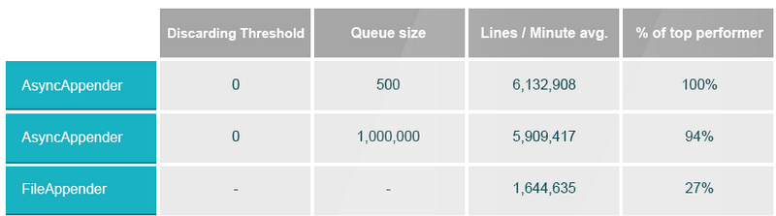
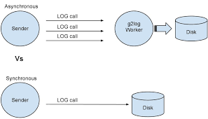
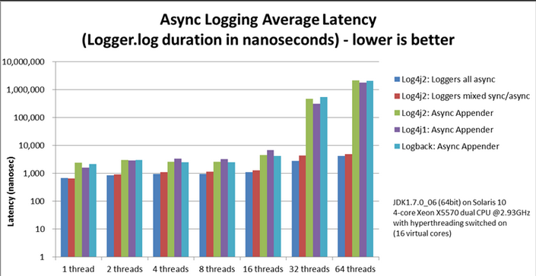
Asynchronous Loggers

Slide 18
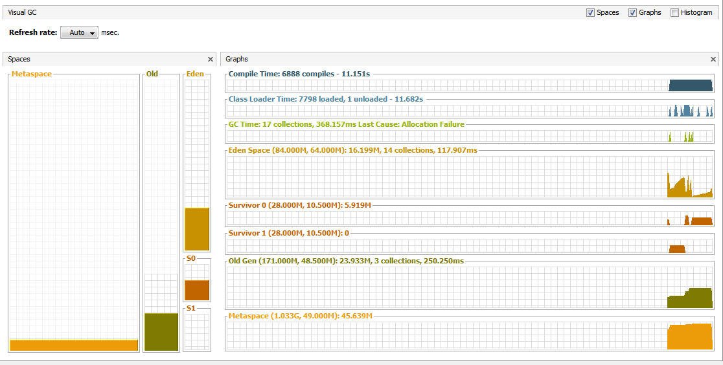
Visual VM

Slide 19
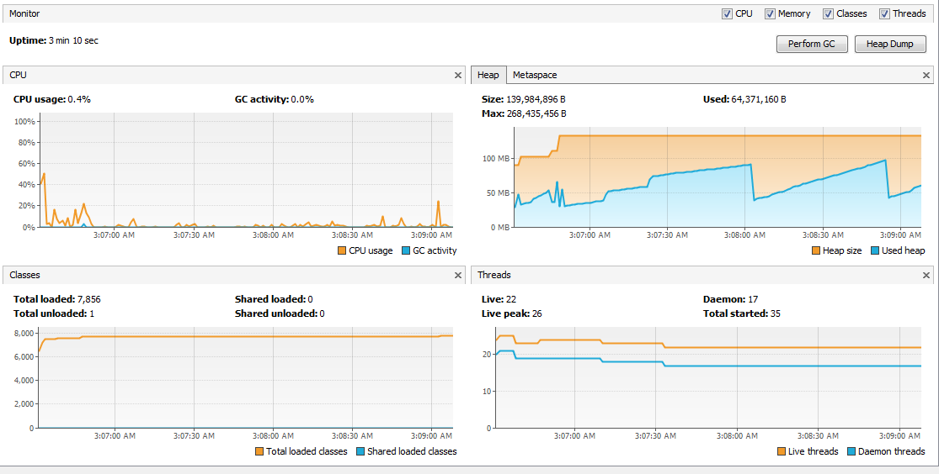
VisualVM

Slide 20
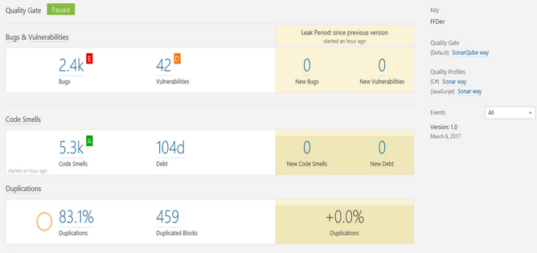
SonarQube

Slide 21
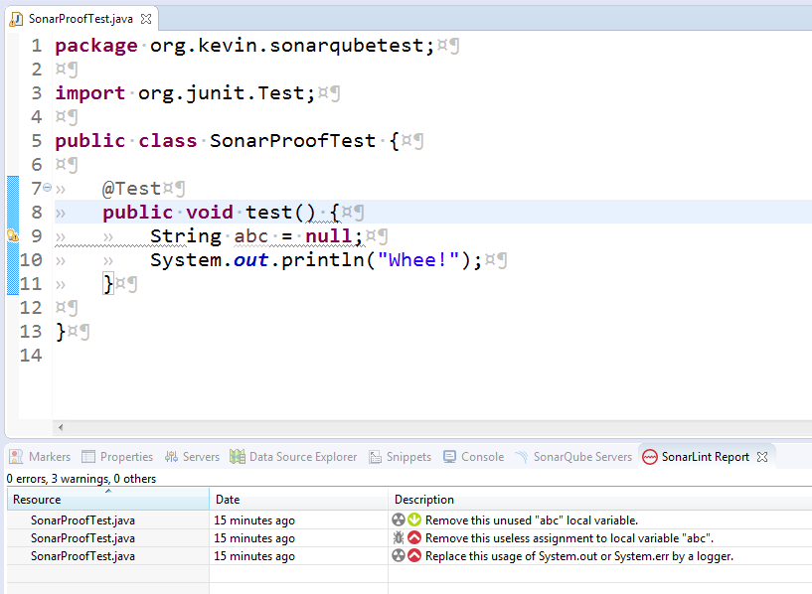
SonarLint

Slide 22
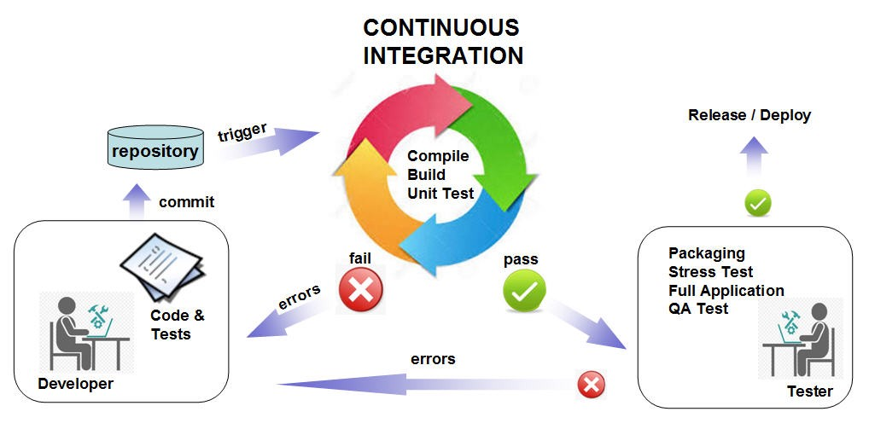
Jenkins

Slide 23
THANK YOU

